Slide 1
Test
Visual Basic

Slide 2

VB Test
40 minutes Open Book Test
8 MCQ and 2 Open Ended Coding Questions (Total of 10 Questions)
Google Form
Save your answer somewhere (Word, Notepad) in case the form is closed accidentally
Run the code in Visual Studio if you do not know the answer

Slide 3
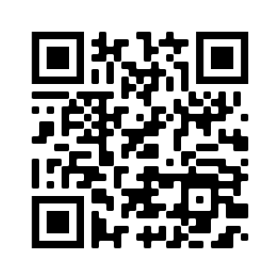
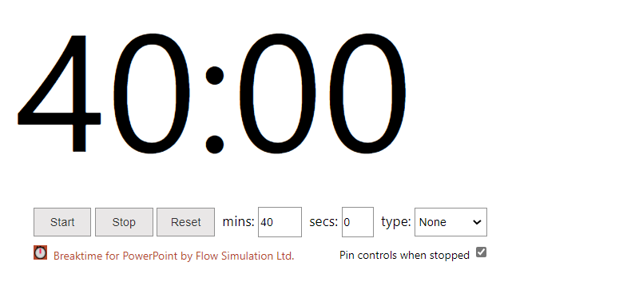
VB Test
Test Link: https://forms.gle/ZV81egTKYxCDSMxVA

